Slide 1

APT1050

Slide 2

Group Members:
Myrrah Muoria -672631
Harina Chohan – 666983
Johnson Kiragu-672070
Britney Wanjiru-672231
Ciary Ben Alok-670688
Florence Nankula 671681

Slide 3

THE PROBLEM

Slide 4

Sports are very important in USIU-A, however, there is a lack of a database system in the monitoring and management of sports equipment.
Currently, the sports management at USIU relies on manual methods to monitor key aspects of its operations. These include tracking the number of players in each team, managing sports equipment inventory, and identifying dysfunctional or broken equipment. Without a centralized database, there is:
Inefficient Player Management: Coordinators face difficulties in obtaining real-time information about team rosters, leading to delays in decision-making.
Poor Equipment Tracking: A lack of clear records for sports equipment results in losses and unpreparedness during events.
Inadequate Maintenance Monitoring: Broken or dysfunctional equipment often goes unnoticed, posing safety risks and disrupting practice sessions.

Slide 5
THE SOLUTION

Slide 6
To address these challenges, I propose the development of a centralized sports database system. This system would offer the following features:
Player Management: A real-time database to track the number of players, their personal details, and team assignments.
Inventory Management: Comprehensive tracking of sports equipment, including the quantity in stock, allocation per team, and usage history.
Maintenance Monitoring: A reporting feature for broken or dysfunctional equipment, with status updates for repairs or replacements.
Implementing a sports database system will significantly enhance the efficiency of sports management at USIU. It will reduce administrative overhead, improve resource allocation, and ensure that the sports teams and facilities operate at their full potential. Furthermore, such a system will align with the university’s vision of embracing technology to drive innovation and excellence.

Slide 7

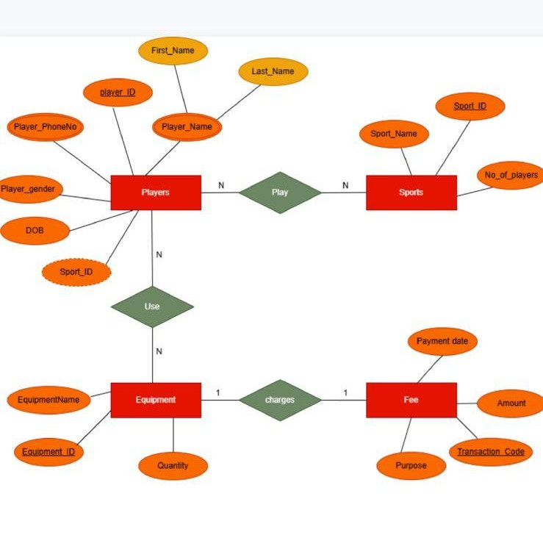
ENTITY RELATIONSHIP DIAGRAM

Slide 8
ENTITIES AND ATTRIBUTES
ENTITIES | ATTRUBUTES
SPORTS | Sport id Sport name Number of players
PLAYERS | Player name(first name, last name) Player id Phone number DOB Gender Sport id

Slide 9
Cont……
ENTITY | ATTRIBUTES
FEES | Transaction code Payment date Amount Purpose Equipment id Player id
EQUIPMENTS | Equipment id Equipment name Quantity Sport id

Slide 10
ENHANCED ENTITY RELATIONSHIP DIAGRAM (ERD)

Slide 11
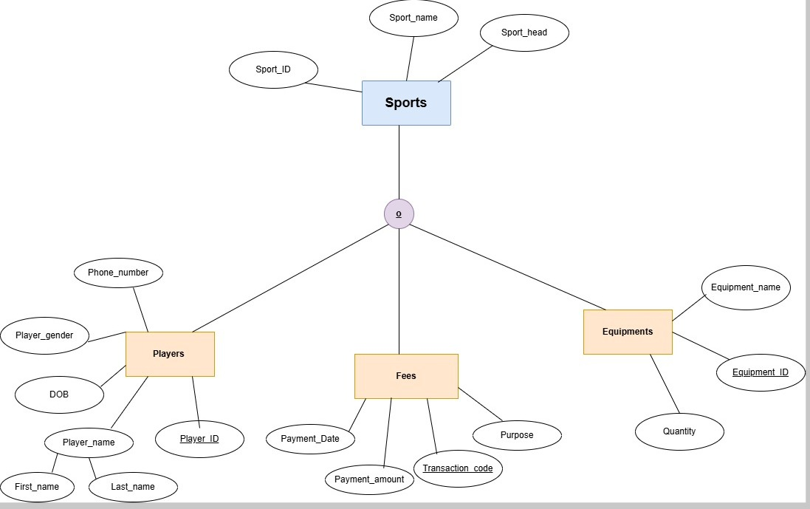

Slide 12
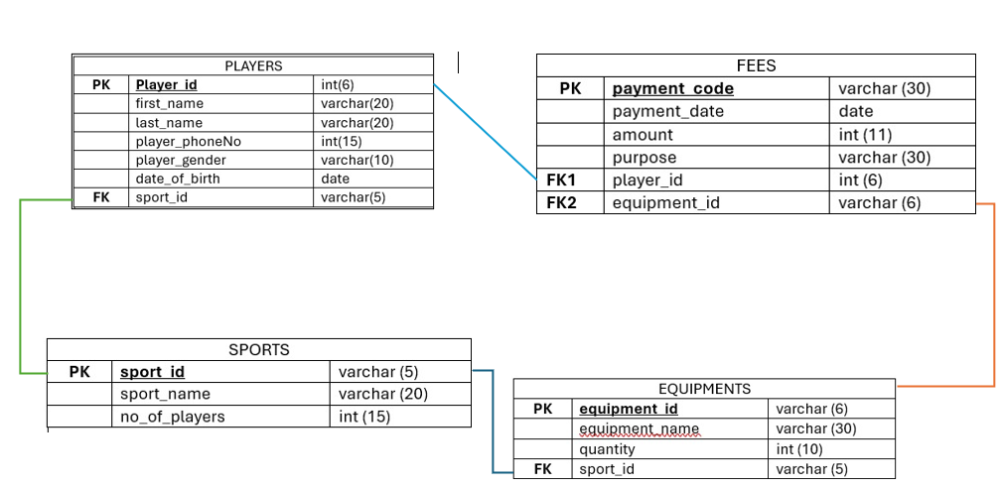
LOGICAL DIAGRAM FOR THE SPORTS DATABASE

Slide 13
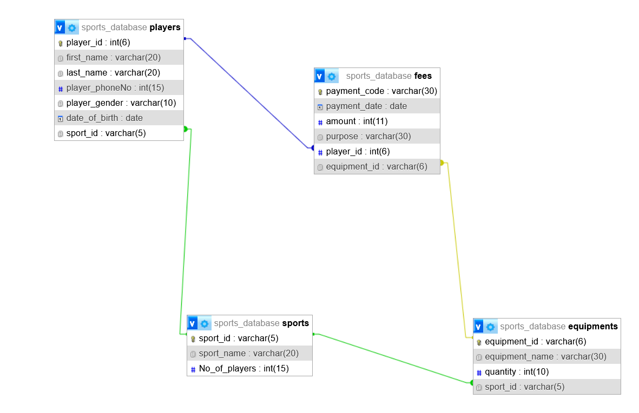
Physical diagram of sports database

Slide 14
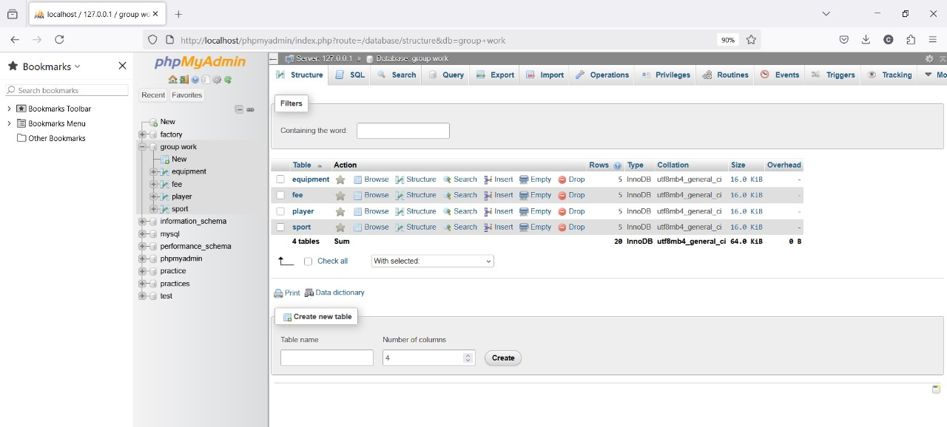
Database

Slide 15
THANK YOU

